Slide 1
Using ML methods to identify
antibiotic resistance mechanism
using proteomics data
Saeideh Nazeri
23.09.2018

Slide 2
How bacteria resist antibiotics
1. To stop the antibiotic from reaching its target at a high enough concentration
Pump the antibiotic out from the bacterial cell, Bacteria can produce pumps that sit in their membrane or cell wall, it can lower the antibiotic concentration inside the bacterial cell.
Decrease permeability of the membrane, Certain changes in the bacterial membrane make it more difficult to pass through.
Destroy the antibiotic, there are bacterial enzymes that can inactivate antibiotics
Modify the antibiotic, Bacteria can sometimes produce enzymes that are capable of adding different chemical groups to antibiotic

Slide 3
How bacteria resist antibiotics
2. Modify or bypass the target of the antibiotic
Hide the target , Changes in the composition or structure of the target in the bacterium (resulting from mutations in the bacterial DNA) can stop the antibiotic from interacting with the target.
Express alternative proteins, that can be used instead of the ones that are inhibited by the antibiotic.
Reprogram target, produce a different variant of a structure ex:make a different cell wall

Slide 4
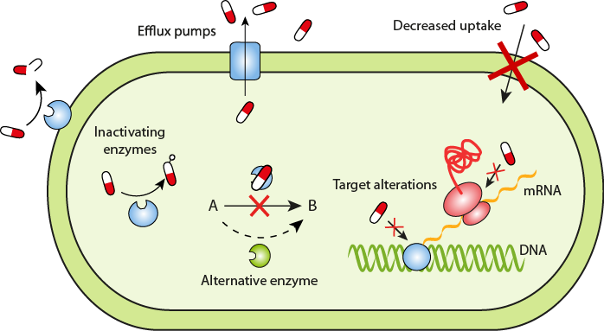
To summerize
The Mechanism reffer to Inhibit
DNA Synthesis
RNA Synthesis
Protein Synthesis
Cell Wall Synthesis
Cell Membrane Synthesis

Slide 5
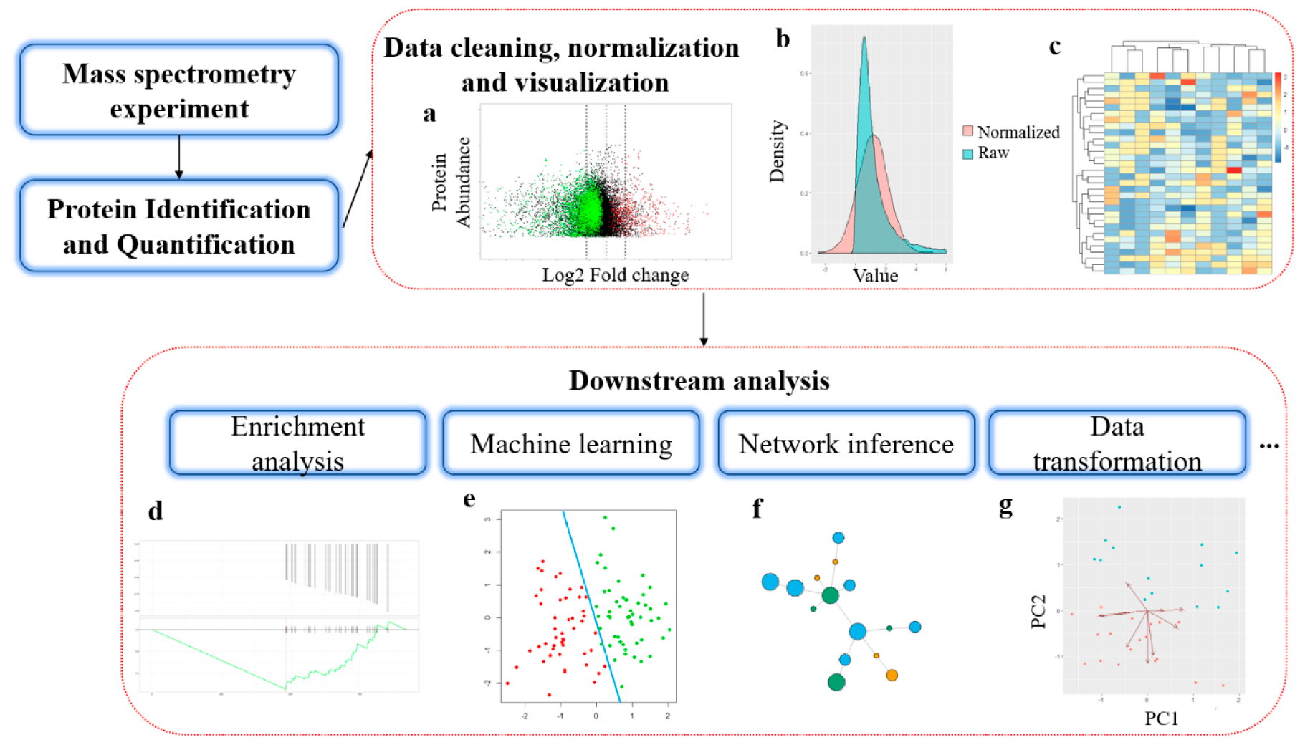
Workflow summary

Slide 6
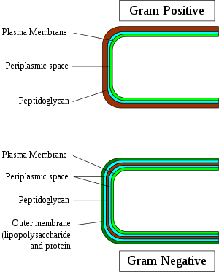
Pseudomonas putida KT2440
Rank: strain Genetic code: Translation table 11 (Bacterial, Archaeal and Plant Plastid)
is a Gram-negative, rod-shaped, saprotrophic soil bacterium.
use of microorganisms to degrade environmental pollutants
Nucleotide | 815
Protein | 11,808
Structure | 85
Genome | 1
GEO Datasets | 390
PubMed Central | 53
Gene | 6,027

Slide 7

Our Data
the response of the Pseudomonas strain KT2440 to seven different types of antibiotics
Ampicilin (AMP)
Ciprofloxacin (CIP)
Chloramphenicol(CHL)
Erythromycin (ERY)
Tetracycline (TET)
KAN
SPEC

Slide 8
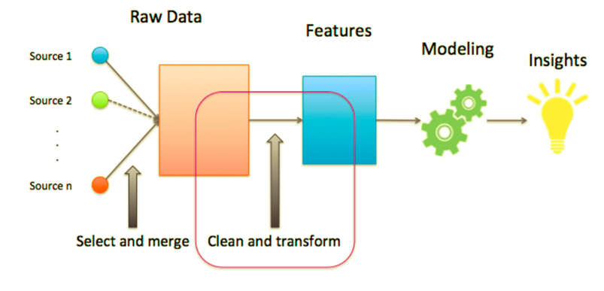
What Machine Learning do?
learn without being explicitly programmed
feed the computer with enough data and give it time to learn from it

Slide 9
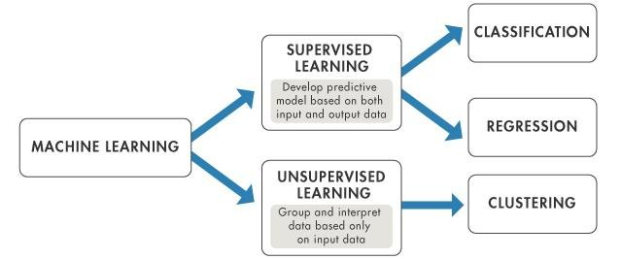
Difference between supervised and unsupervised learning

Slide 10
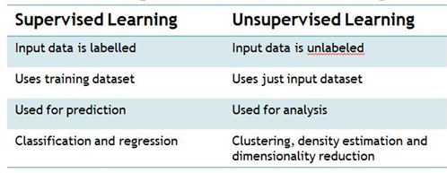

Slide 11
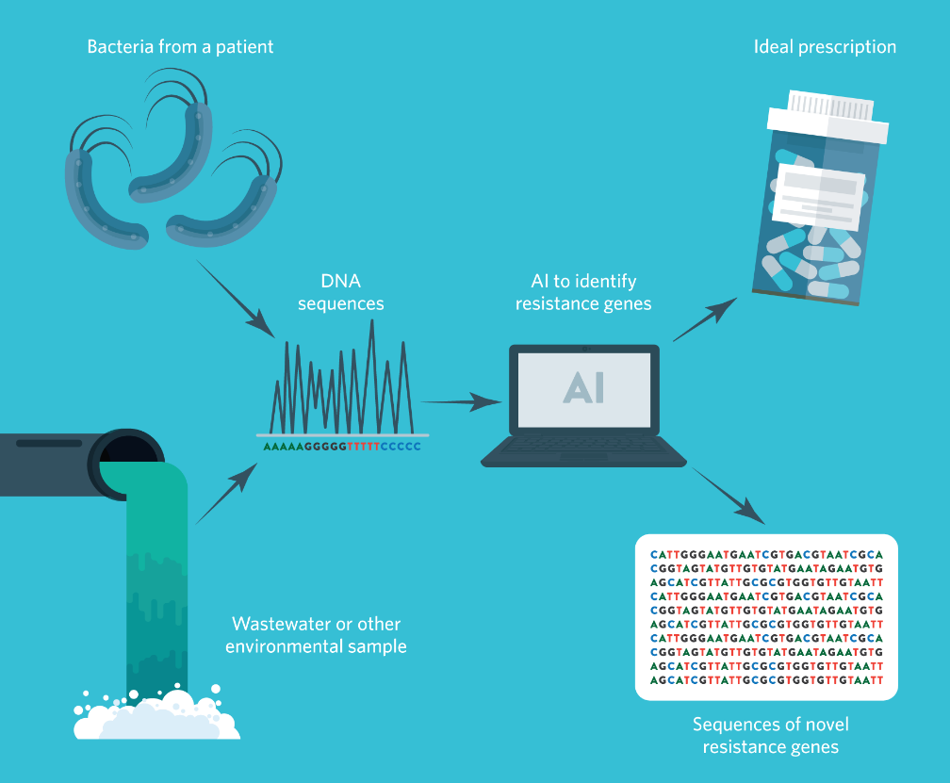
Type of Study that has already done
Machine learning algorithms that
predict antibiotic resistance from
whole genome sequences
sequence the DNA of the new
bacteria causing an infection
analyse this DNA sequence data
to predict which antibiotics
could be successfully used to
treat the infection

Slide 12
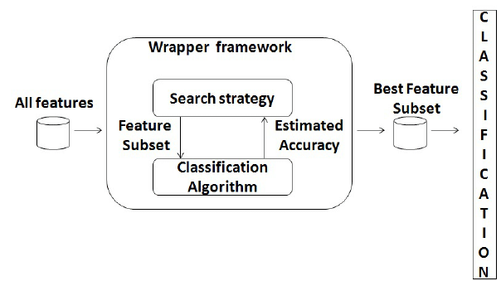
Data Fearures
Quantification of upregulated proteins
Enrichment analysis
Biological process
Cellular component
Molecular function
Protein domains
Site of expression(tissue or cell types)
Biological pathways
Transcription factors
Clinical synopsis phenotypic terms
New feature Suggesion?

Slide 13
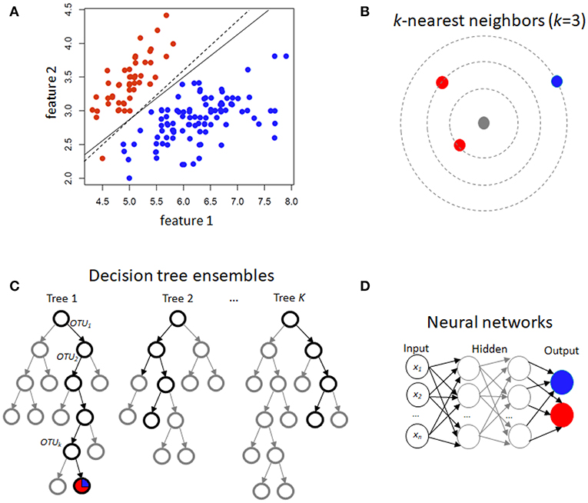
supervised method

Slide 14
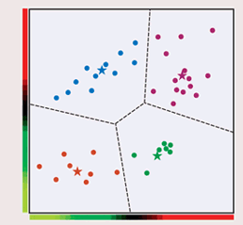
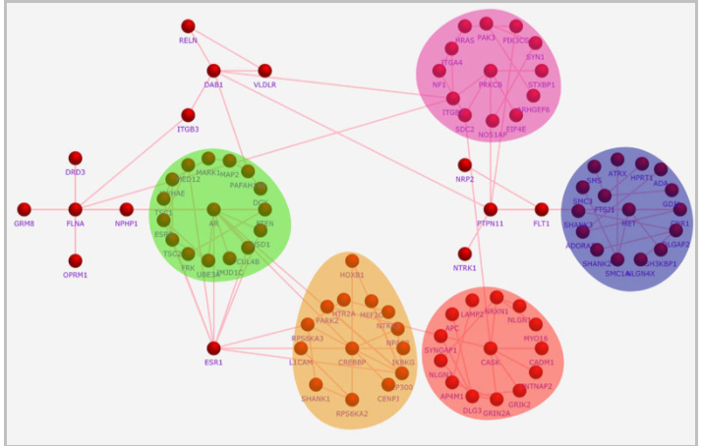
unsupervised methods
Clustering Example

Slide 15
Thank you

